Slide 1
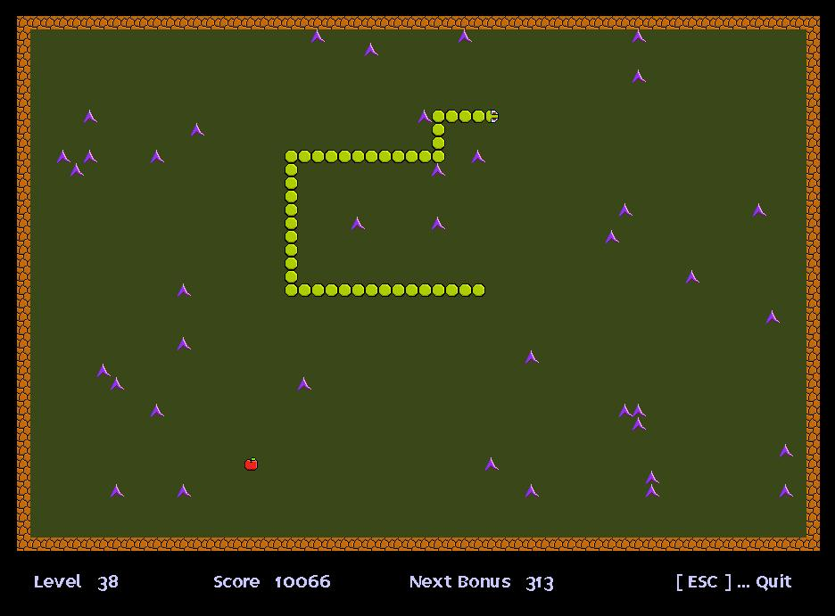
Homework
Create the Snake game using the Revealing module pattern. Design the game such that it has at least three modules.

